Slide 1
The machine learning 101 and Basic of Tensorflow
Yi-Fan Liou

Slide 2
Agenda
Course
The basic of machine learning
Installation of Tensorflow
Multilayer perceptron
Convolutional neural network

Slide 3
About the speaker
Yi-Fan Liou
You can call me Mark as well
I am not a teacher… I don’t think I am qualified …
Ex-cofounders of many start-up team
Confounder of the Taipei Bioinformatics Omnibus (Facebook 社團，歡迎有興趣的人加入)
Specialist
Bioinformatics and Proteomics
I know you are not interested in …
But … if we only focus on machine learning and GPU using experience
Machine learning since 2009
CUDA programing since 2011
Finally
This is a casual course, please feel free to ask any questions. (我目前單身，先回答各位)
I am not always right. Tell me anything if I am wrong.
很重要所以打中文: 如果我詢問各位問題希望各位舉手時，我只是想了解目前各位的狀況，不會強迫各位發言(如果有人迫切想發言當然也不會阻止)

Slide 4
The Basic

Slide 5
Linear regression
Can you please google this?
Just kidding
y = Ax + b
0

Slide 6
Logistic regression – from statistic
Set: All the dependent variables are linear
continuous : least square errors
categorical : continuous with some errors
Y = a1x1 + a2x2 + …. + anxn + b
Ideally
Y = a1x1 + a2x2 + …. + anxn + b
Never forget : the least square assume the normal distribution
This concept make a straight line
prefer
Normal distribution
Extreme error would not
often happen
Not prefer
error

Slide 7
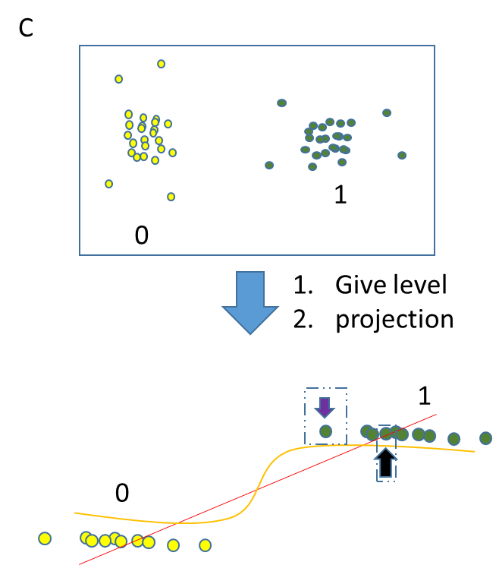
Logistic regression – from statistic
Set: All the dependent variables are linear
continuous : least square errors
categorical : continuous with some errors
Y = a1x1 + a2x2 + …. + anxn + b
Classification case
Y = a1x1 + a2x2 + …. + anxn + b
If you want to fit this line ….
This concept also make a straight line
It will be like this ….
NOT
Normal distribution
It is obviously : the errors between the line and data
won’t be normal distribution
1 or 0
error
That’s why the classification problem never use MSE as loss
( you can use MSE, but it will make a tragedy )
feature

Slide 8
Bias in categories
A
C
1
0
Give level
projection
B
1
0

Slide 9
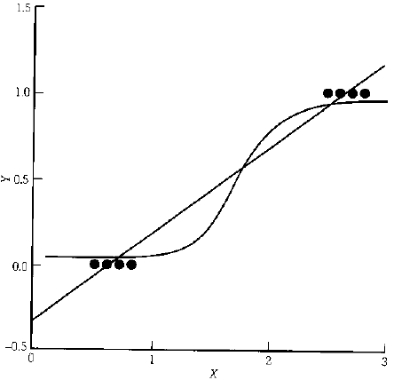
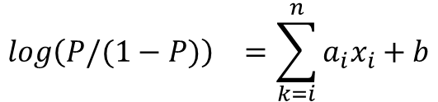
Logistic regression – from statistic
Regularly, the upper bond and lower bond is from 0~1
Why not use “ratio”?
$${log\left(P/(1−P)\right)}^{}=\sum_{k=i}^{n}{a_{i}x_{i}+b}$$
case
Control
(total samples except the cases)
Odds ratio
According to “maximum likelihood”, using the optimization method can get the odds ratio
http://janda.org/workshop/Discriminant%20analysis/Talk/talk01.htm
Newton
Gradient decent

Slide 10
Maximum likelihood V.S. cross entropy
In machine learning, the loss usually use cross entropy
In statistics, the gain usually use maximum likelihood
But Don’t worry, they are the same …

Slide 11
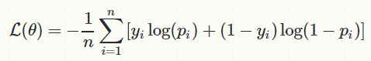
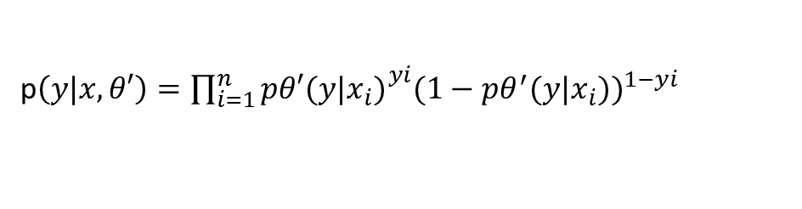
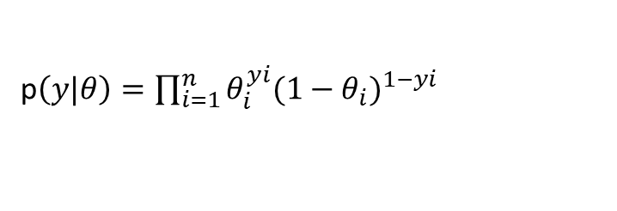
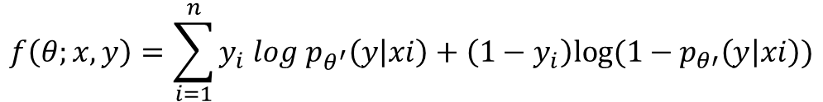
The relation between BCE and ML
BCE = binary cross entropy ML = maximum likelihood
Set : the problem is simple as bi-classification
The ML can applied as Bernoulli
Bernoulli
p$\left(y|θ\right)=\prod_{i=1}^{n}{θ_{i}^{yi}{(1−θ_{i})}^{1−yi}}$
This is a distribution from model, so..
Let p(x|θ’) denote the training model θ
p$\left(y|x,θ′\right)=\prod_{i=1}^{n}{{pθ′(y|x_{i})}_{}^{yi}{(1−pθ^{′}(y|x_{i}))}^{1−yi}}$
How about give a ‘log’ ?
$$f\left(θ;x,y\right)=\sum_{i=1}^{n}{y_{i} log{ p}_{θ^{′}}\left(y | xi\right)+\left(1−y_{i}\right)log⁡(1−p_{θ′}\left(y | xi\right))}$$
BCE
https://stats.stackexchange.com/questions/260505/machine-learning-should-i-use-a-categorical-cross-entropy-or-binary-cross-entro

Slide 12
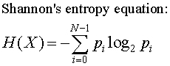
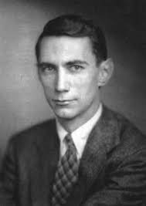
Logistic regression in the modern time
Most people know logistic regression which is used to “predict” something rather than “describe” something.
What’s different between the “old” time and “fashion” time
Optimizers:
gradient decent V.S Newton’s method
Objective functions
Maximize likelihood V.S Minimizing cross-entropy
Binominal Cross-entropy
https://stats.stackexchange.com/questions/260505/machine-learning-should-i-use-a-categorical-cross-entropy-or-binary-cross-entro

Slide 13
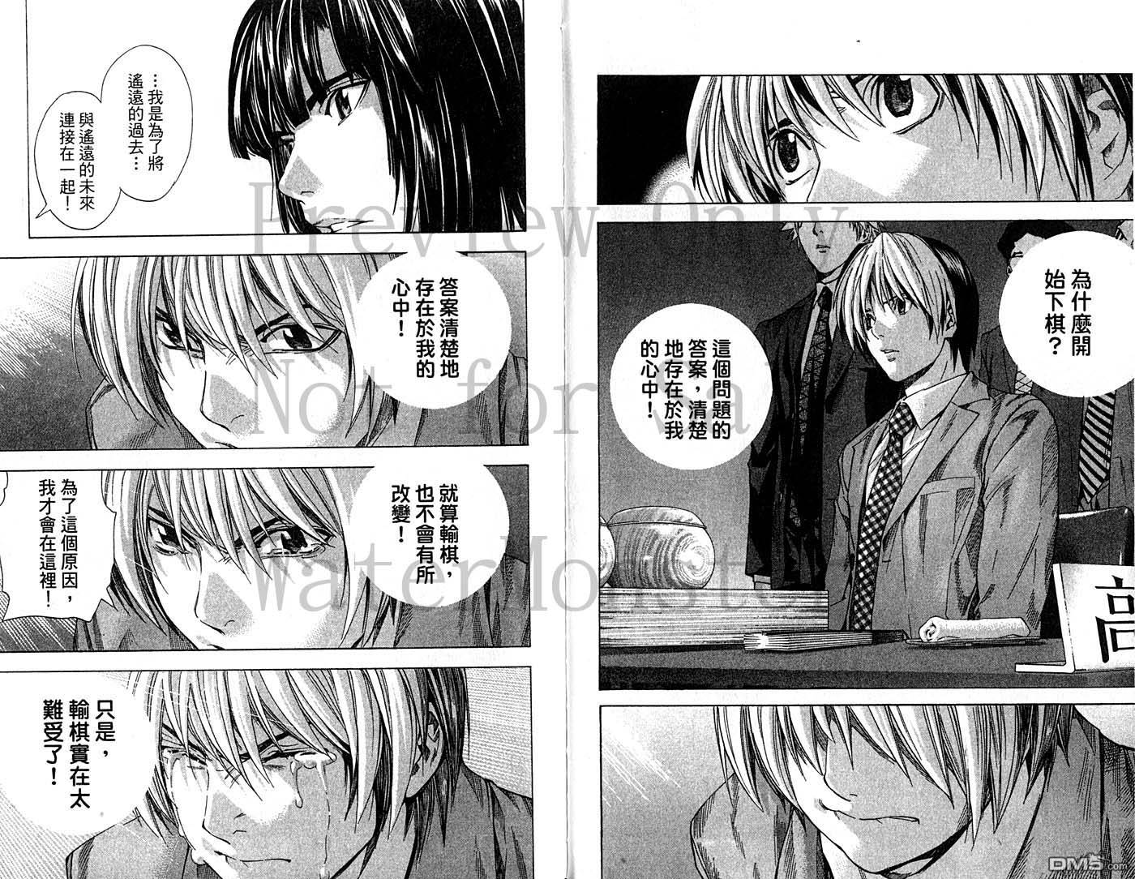
Why logistic regression?
為什麼用邏吉思迴歸
Some concepts in machine learning is also from the statistics.
They are quite similar!!
You can find the logit models in:
Traditional statistics – ex. Survival analysis
Machine learning

Slide 14
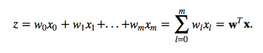
The architecture of Logit model
softmax

Slide 15
Basic Terms of machine learning

Slide 16
Loss
The basic concept of machine learning is to estimate the probability of the dataset.
We use the probability to predict the unknown ones.
This term, loss, give the information of how far between the estimated probability and real probability
estimated
real
In category classification task, we usually use “cross entropy” to estimate the difference between the distributions.
loss

Slide 17
Estimating the training
The training strategies are simply discussed with two domain
For “weights” – calculate the loss for directly updating model
Batch
Epoch
For “hyerparamters” – calculating the loss for estimating the performance
Validation
Corss validation
N-fold
Leave one out
Holeout validation

Slide 18
Updating the weights – whole dataset
Dataset
Model
feed
loss
This is most intuiting method for updating the weights
feedback

Slide 19
Updating the weights – original stochastic method
Updating the model using whole dataset cause the “overfitting” issue
Dataset
Feed only one data
Model
loss
Updating the model using one-by-one data prevent the overfitting
feedback

Slide 20
Updating the weights – stochastic mini-batch method
Updating the model using stochastic method would be influence by the noise.
Dataset
Feed several data
Model
loss
This method can slightly prevent overfitting and efficiently use the memory
This method becomes a “classical” in training model
feedback

Slide 21
Batch? Epoch?
The dataset will feed into the model.
The model will be train again and again
Dataset
Mini
batch
Feed several data
Model
loss
If you train the model using the mini-batch method and the dataset is limited, one day you will train the model with whole dataset. Then, you reuse the dataset to train again.
One cycle mean one epoch
feedback

Slide 22
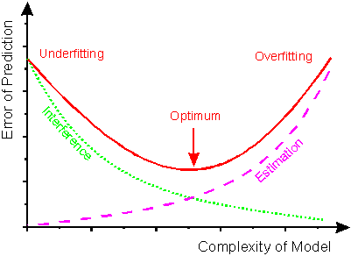
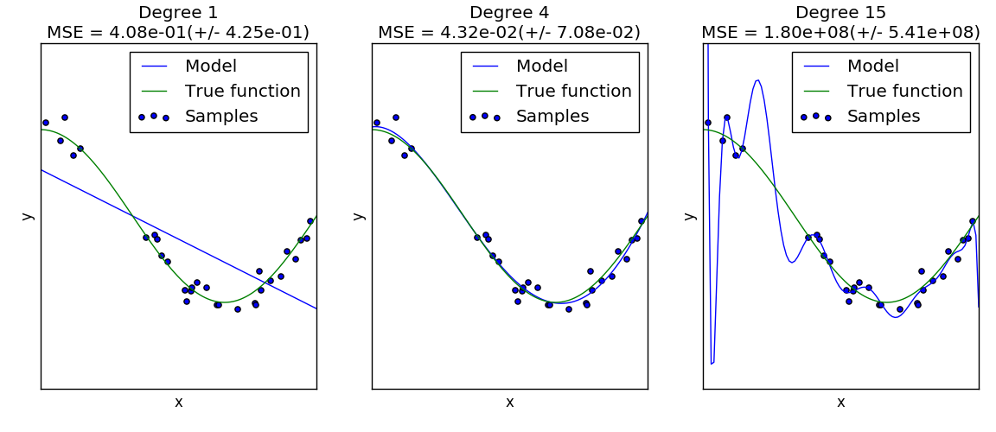
The classic overfitting issue
http://lijiancheng0614.github.io/scikit-learn/auto_examples/model_selection/plot_underfitting_overfitting.html
http://www.frank-dieterle.de/phd/images/image024.gif

Slide 23
Training, Test, Validation
Training
Test
Validation
Why validation?
Test dataset
Depending on the dataset resources
????
Train Dataset
Validation

Slide 24
More about validations
holdout validation
Most use in modern model, especially with “early-stopping”
Cross-validation
Leave-one-out cross validation
Train Dataset
Validation

Slide 25
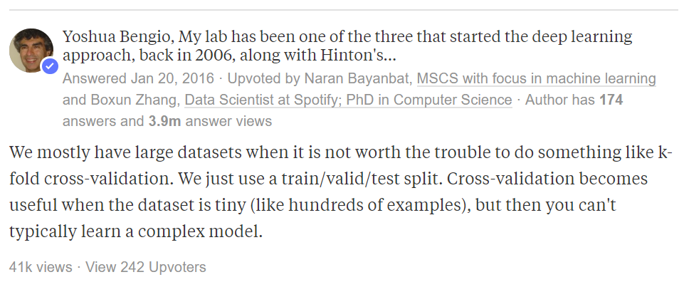
Cross validation in deep learning ?
https://www.quora.com/Is-cross-validation-heavily-used-in-deep-learning-or-is-it-too-expensive-to-be-used

Slide 26
The basic of the tensors
Using Numpy and Tensorflow

Slide 27
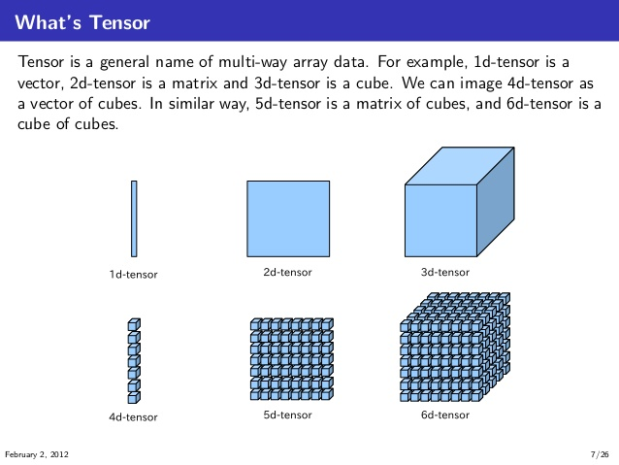
What is “tensor” ?
“A tensor is a generalization of vectors and matrices to potentially higher dimension”
--https://www.tensorflow.org/programmers_guide/tensors
https://stackoverflow.com/questions/37849322/how-to-understand-the-term-tensor-in-tensorflow

Slide 28
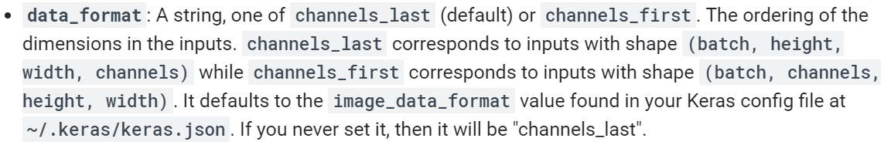
The shape of tensor
[3,4,5]
Picture format
[5]
[4,5]
The format:(NHWC)
(batch size, height, width, channel)
https://www.tensorflow.org/api_docs/python/tf/keras/layers/Conv2D

Slide 29
tf.matmul
This is same to weighted sum
1
2
3
a = tf.Variable([[1,2,3],[4,5,6]])
b = tf.Variable([[1,2,3]])
c = tf.matmul(a,b)
1 2 3
4 5 6
1 * 1 + 2 * 2 + 3 * 3 = 14
14
32
4 * 1 + 5 * 2 + 6 * 3 = 32
1 2
3 4
5 6
1 2 3
4 5 6
22 28
49 64
a = tf.Variable([[1,2,3],[4,5,6]])
b = tf.Variable([[1,2],[3,4],[5,6]])
c = tf.matmul(a,b)
What’s the answer?

Slide 30
Weighted sum
1
2
3
1 2 3
4 5 6
X1 = 1
X2 = 2
X3 = 3
y = 1*X1 + 2*X2 + 3*X3
X1 = 4
X2 = 5
X3 = 6

Slide 31
Weighted sum
1
2
3
1 2 3
4 5 6
X1 = 1
X2 = 2
X3 = 3
y = 1*X1 + 2*X2 + 3*X3
X1 = 4
X2 = 5
X3 = 6

Slide 32
How weighted-sum used in neural network
Assume we have a simple linear function:
F(x) = 2.5 X1 + 1.4 X2 + 0.2 X3 + 0.2 X4 + 4.5 X5
f(x) = 25 X1 + 14 X2 + 2 X3 + 2 X4 + 45 X5
x1
x2
x3
x4
x5
0mutmul_sample.py

Slide 33
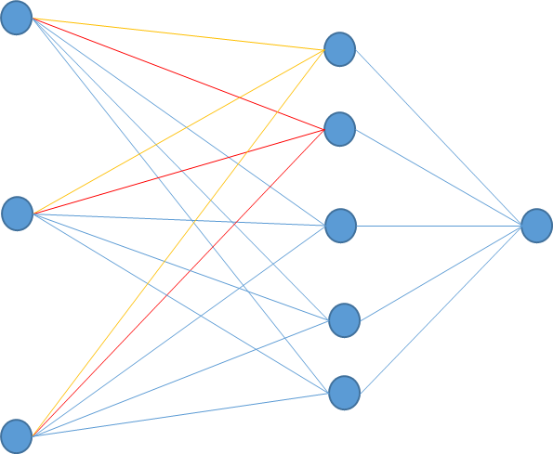
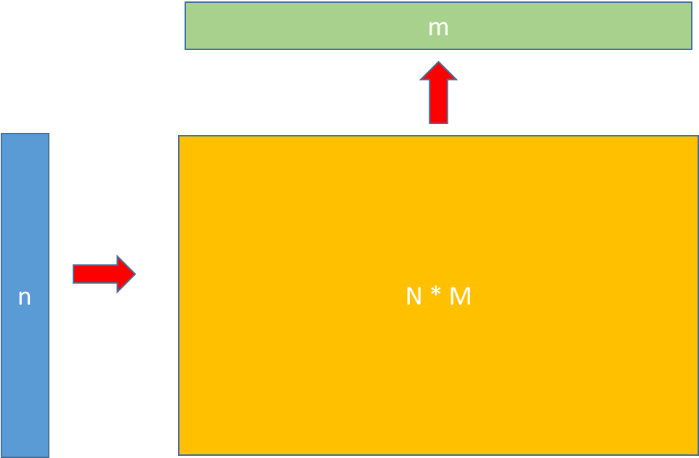
Another words
Use MNIST as example.
Make a MLP network and optimize it using gradient decent

Slide 34
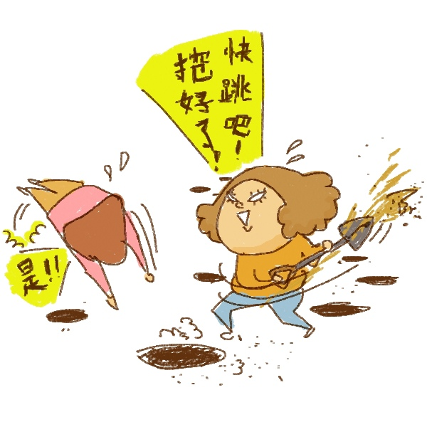
But… How to train it??
I will try to explain it just use the essential math concept.
http://bimay.pixnet.net/blog/post/11410360-%E8%AA%AA%E8%A9%B1%E7%9A%84%E8%97%9D%E8%A1%93

Slide 35
The basic concept of Tensorflow
Static computation graph
You need to define the whole graph before you run a complete process
The framework will deploy your job to the corresponding computing nodes
By the way
Dynamic computational graph
pyTorch
Eager execution

Slide 36
Process diagram
Import modules
Results
Draw your NN architecture
Start a Tensorflow session

Slide 37
Session is a “canvas”
Import tensorflow as tf
a = tf.Variable([1,2,3])
b = tf.Variable([4,5,6])
c = a + b
They are just occupy in the python
a
b
Tensorflow
c
sess = tf.session()
sess.run(c)
sess.close()
Session
Tip:
Once the Session announced, the architecture fixed.
Once the operators announced, it will live until you close Python (advance)
Since the architecture is fixed, we usually use ‘ delivery pores’ for feeding the data.
a
c
b

Slide 38
The basic operation in tensor calculating
We will compare the basic operator between python and Tensorflow
Since python did not have an exact ‘array’, we use the “list” to instead
add
How about “weighted sum” ?
tf.add(x,y)
tf.reduce_sum( tf.matmul(x,y) )
multiply
tf.matmul(x,y)
tf multiply(x,y)??

Slide 39
Example 1.
Task : we use Tensorflow to complete some simple operation
Add 2 tensors
Multiply 2 tensors
Division 2 tensors

Slide 40
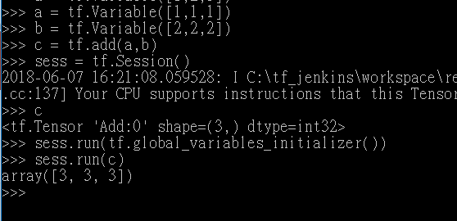
tf.add
1
1
1
1
+
2
2
2
2
3
3
3
3

Slide 41
Try to make a model with Tensorflow

Slide 42

The objective
Image that …
If we get some error in the function, can we modify the coefficients of the function to get more correct results?
h
x
softmax
The most method is stochastic gradient decent …
y
W
b
Only 1 channel with the width and height of 28 and 28, respectively.
Find them!!
1softmax_regression_MNIST.py

Slide 43
Multilayer perceptrons

Slide 44
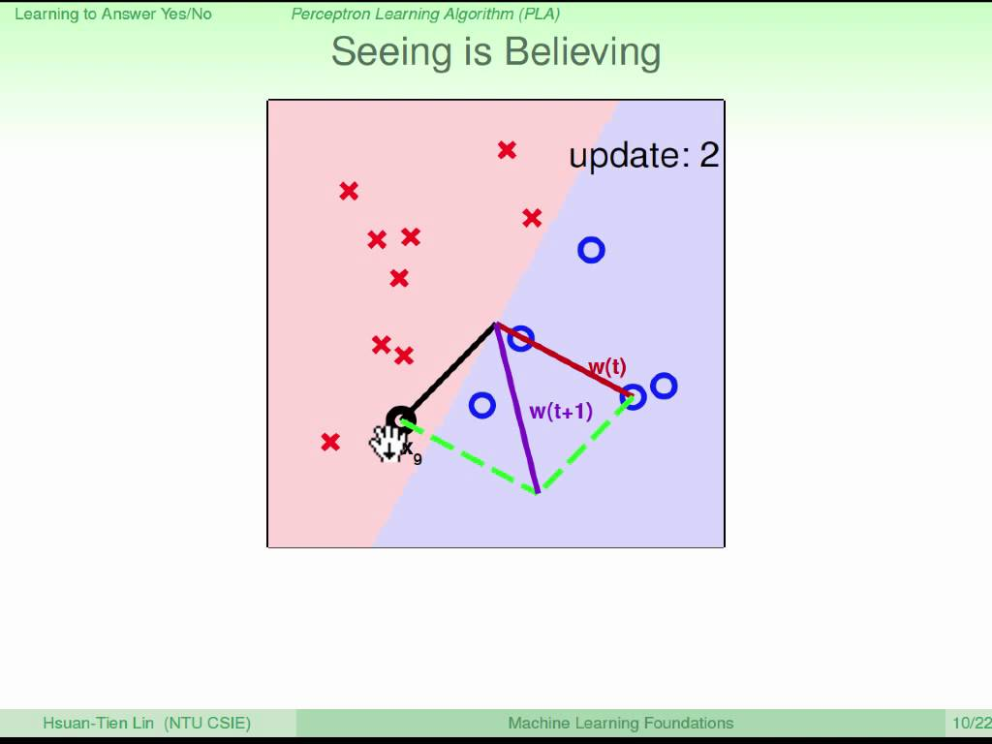
Small story – Perceptron learning
Target: We want to use a simple line as decision boundary
y
1 if y >0
-1 if y <0
1 perceptron can define a simple decision boundary.
XOR problem
H.T. Lin, “Machine Learning Foundations”
"Perceptrons: An Introduction to Computational Geometry", Minsky and Papert

Slide 45
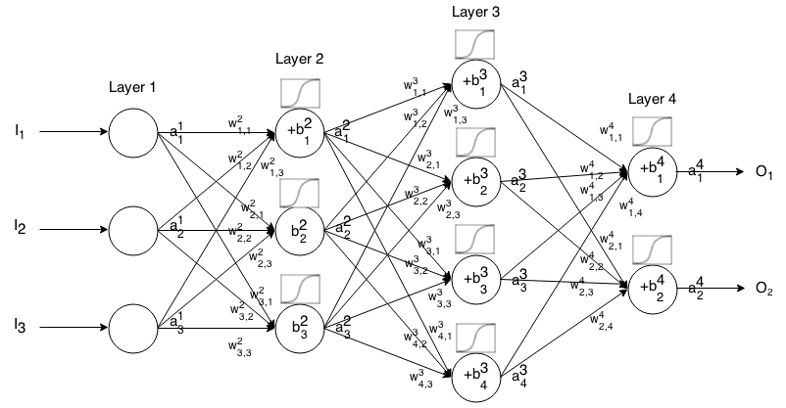
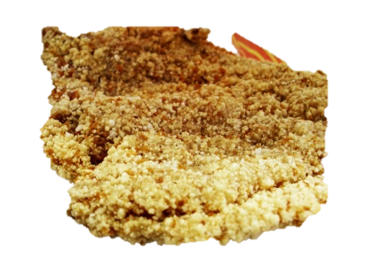

Multi-layer perceptron
N = 1
N = 2
Weighted sum
N = m

Slide 46
MLP practice
x
h1
h2
y
w1
w2
b1
b2
2MLP_MINST.py

Slide 47
Practice 1
Please create a MLP for predicting the MNIST dataset. The parameters are define as
3 layers
128
512
256
Batch size
256
Epoch
5000

Slide 48
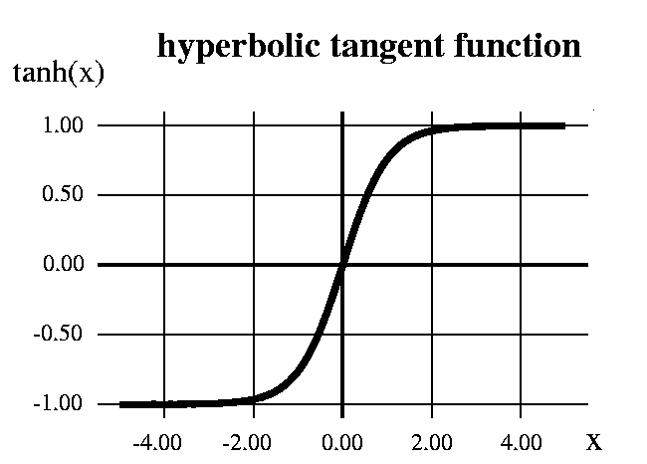
The activation function
https://towardsdatascience.com/activation-functions-and-its-types-which-is-better-a9a5310cc8f
2sparseMLP_MINST.py

Slide 49
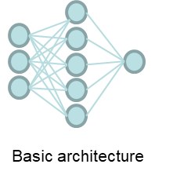
Demo time~
Many interesting things happened. Many people cannot answer them using current math theories.
https://github.com/Bcondux/WorkShopCentSci20180609/blob/master/SampleCode/multilayer_perceptron_overfit.py
matmul :

Slide 50
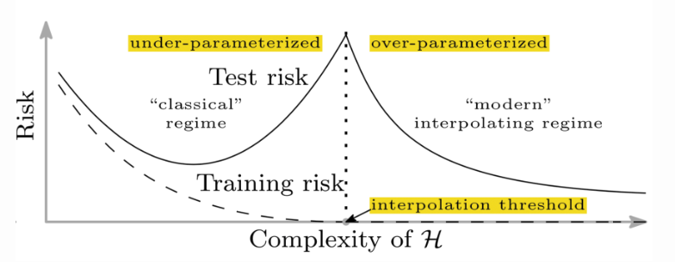
Overparameterization – The update
https://arxiv.org/abs/1812.11118

Slide 51
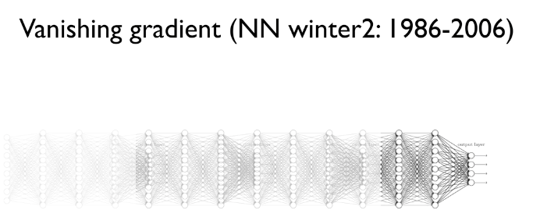
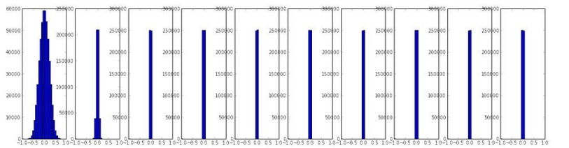
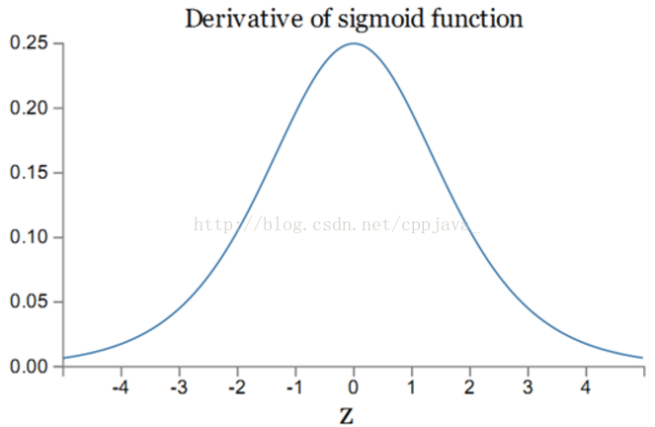
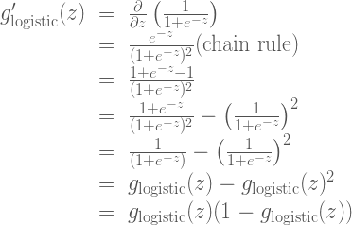
How hard will deeper models be?
Gradient vanishing
https://towardsdatascience.com/activation-functions-and-its-types-which-is-better-a9a5310cc8f
http://cswithjames.com/keras-6-vanishing-gradient-problem-relu/
http://blog.csdn.net/zjucor/article/details/7815
Only 1/4
https://blog.csdn.net/cppjava_/article/details/68941436

Slide 52
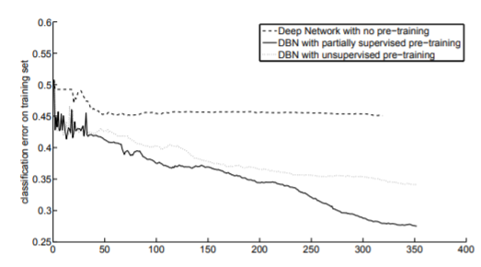
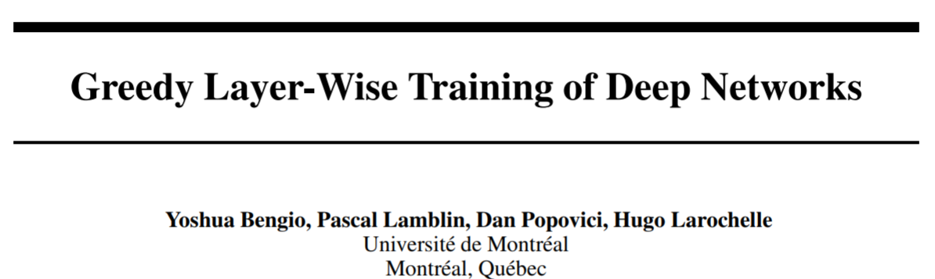
The power of deeper model
Pretrain ---- the old fashion style
Restricted Boltzmann machine (RBM)
compare
Input data
forward
backward

Slide 53

Activation functions
The activation function help the NN
Now, the problem is mainly the computing resources
https://medium.com/machine-learning-world/how-to-debug-neural-networks-manual-dc2a200f10f2

Slide 54
Convolutional neural network

Slide 55

Considering the transform of the NN
Weighted sum
How about…
If we already know the “triplet pattern” appears anywhere of the input?
=> Yes, we can use the same weights for weighted sum
Basic architecture
…….
…….
Assume we already know the input data have “triplet pattern”
receptive field
We use the same weight for weighted-sum operation
Weight sharing
Save more variables
Regulating the weights

Slide 56
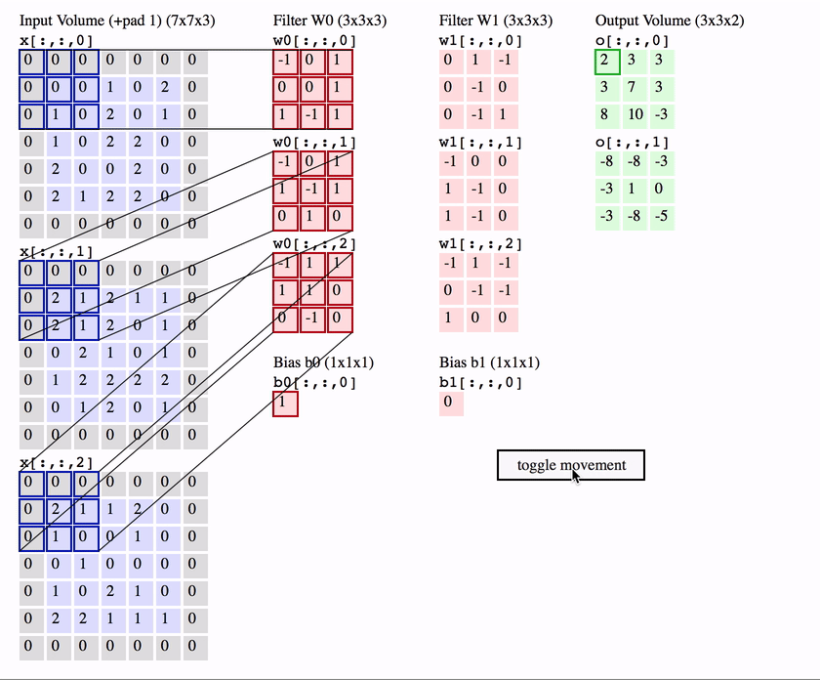
Convolutional neural network
Normal terms:
Kernel size
Stride
padding
https://medium.com/@phidaouss/convolutional-neural-networks-cnn-or-convnets-d7c688b0a207

Slide 57
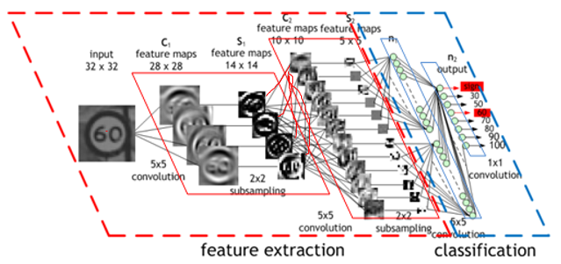
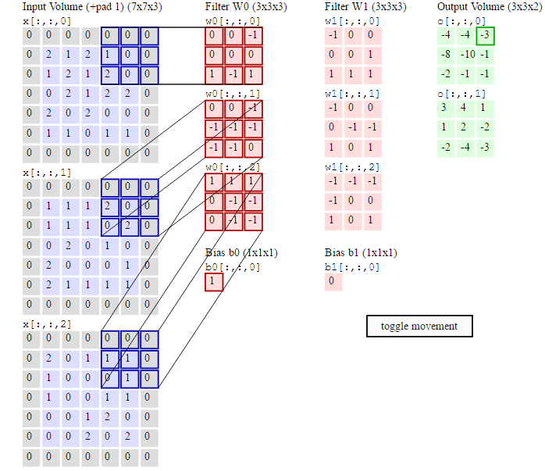
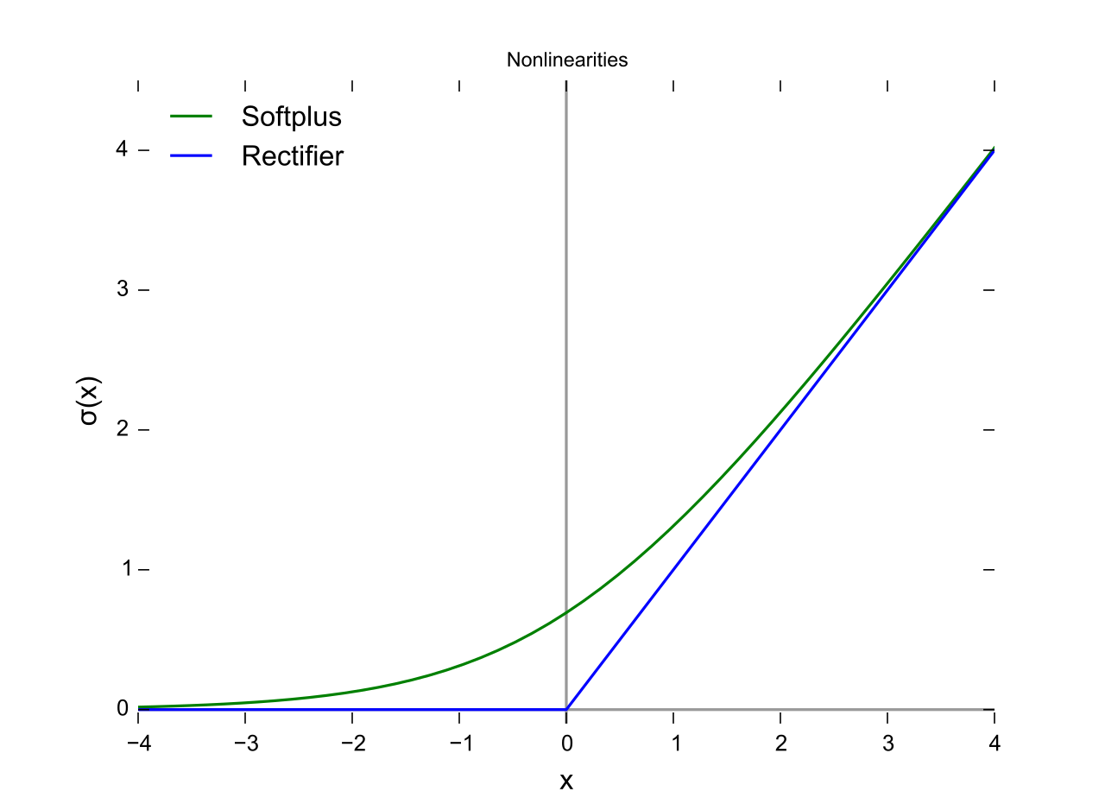
How about convolutional neural network
http://www.cnblogs.com/walccott/p/4957076.html
CNN is also a kind of NNs, but the hidden nodes have their own receptive fields and sharing their weights
Each “feature map” is a node.
The ability for classification is still from the fully connected NN.
This also means, appending deeper layer here would cause gradient vanishment
https://www.quora.com/In-a-convolutional-neural-network-how-is-convolution-defined-with-an-RGB-image
Subsampling: pooling method

Slide 58
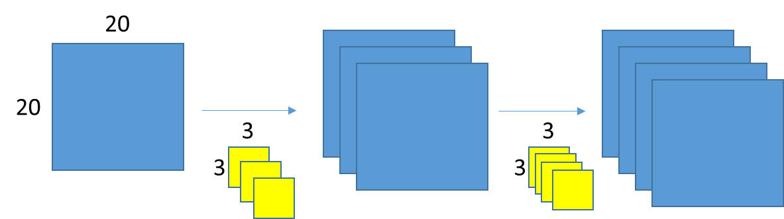
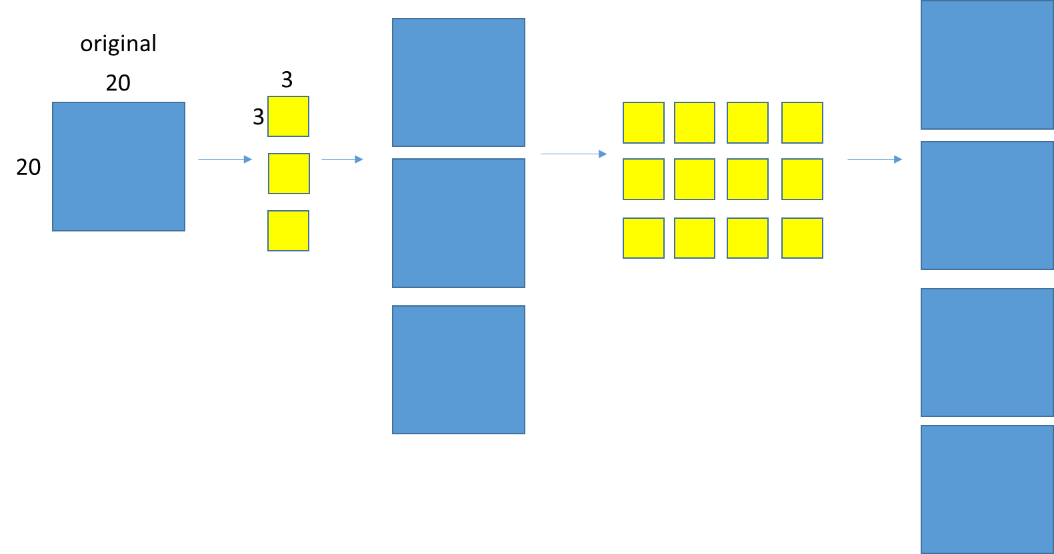
The parameters – CNN as example in detail
Condition :
No pooling layer
Do not consider the activation function
original
3
20
3
20
Correction:
20 * 20 = 400
3 * 3 * 3 = 27
400 *3 = 1200
3 * 3 * 4 * 3 = 108
400 * 4 = 1600
Total:
400 + 27 + 1200 + 108 + 1600 = 3335
3335 * 4 (byte) = 13340
(previous : 556 bytes)
batch
The precious counting miss these condition !
(This is also HMM )
100
…..
??
accelerating

Slide 59
BTW: Fully convolutional neural network
4
4
1
2
2
1
pooling
convolution
pooling
convolution
convolution
4
4
2
pooling
convolution

Slide 60
Convolutional neural network practice
Many convenient tools are already invented. But to better understanding how the tensors flow, we try to implement it as detailed as possible.
3CNN.py
The next step is the Keras module in Tensorflow
3CNN_keras.py
Thank you~

Slide 61
Bcondux Co., LTD
寶定有限公司
Sales@bcondux.com
03-4503585

